Slide 1
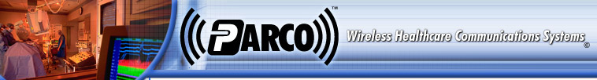

Parco RTLS™ SDK
Overview
Parco Wireless has created a Software Development Toolkit (SDK) to facilitate the rapid development of 3rd party applications. The SDK provides a simple object oriented API (application programming interface) to access the Parco RTLS™ (Real Time Location System). The SDK provides real time streaming data, historical data playback, and geo-location information management capabilities.

Slide 2
The Parco RTLS™ Services Suite is based on the latest in Microsoft Dot Net technology and uses TCP/IP networking, XML Web Services, and SQL Server 2000 running on the Windows 2000/2003 Server platforms.
The Services Suite is designed to be scalable in a high data environment and to isolate your network from excessive traffic. RFID systems have the potential to produce very large amount of data.

Slide 3
The SDK is the interface to the Parco RTLS™. It is written in Visual Basic Dot Net and uses version 1.1 of the Microsoft Dot Net Framework. Any of the diverse array Dot Net programming languages may be used to develop your application.
The SDK may be installed on any client that supports the Dot Net Framework. Installations are made simple by using XCopy deployment to your end user’s computers. The SDK is not an application, but the toolkit containing business objects used to rapidly create services and applications.

Slide 4
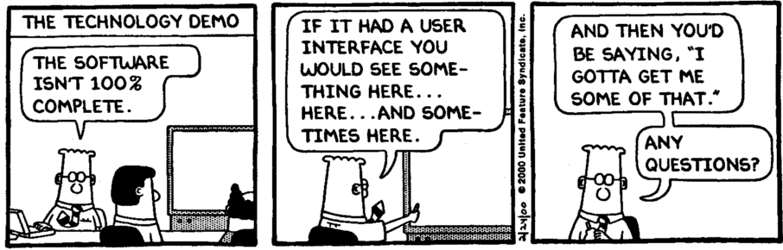

Slide 5
Your developers can take full advantage of the Parco RTLS™ Services Suite through the SDK. The SDK offers a simple object-oriented, event driven environment to program against. All of the system connectivity (TCP/IP and XML Web Services) is performed within the SDK. This allows your developers to rapidly create an application without having to develop new infrastructure.

Slide 6
Parco RTLS Services
The Parco RTLS Services Suite consists of:
  XML (SOAP) Web Service for Data Access
  SQL Server 2000 Databases for RTLS History and RTLS asset management.
  Streaming GIS data services to provide real time XML based asset location from the Parco RTLS hardware.
    Streaming data resources:
      Full Stream services send all available data.
      Subscription based services send only the data that is requested.
      Resources are setup by Parco according customer needs.
      XML based for cross OS support.

Slide 7
Parco RTLS™ SDK
The RTLS SDK provides application connectivity to all system resources and services.
  Provides a simple, object oriented, event driven programming environment.
  Data access may be accomplished through business objects or datasets.
  MSDN style help file and sample applications.
  Supports logical assignments between assets and tags.
  Virtual VCR for location information play back.
  Triggers for event notifications of asset movement
  Supports polygonal architectural areas and user defined regions.
  Real time location information.
  Near real time database location information.

Slide 8
Parco RTLS™ Viewer SDK
RTLS 3DViewer SDK
  Minimal Direct-X9 knowledge required.
  Easy to use managed Direct-X9 based wrapper
  Programmable gaming style Mini-Map for user orientation
  Support for Tags and tag children
  MSDN style help file
  Sample Application

Slide 9
Parco Developer Toolset
Test Manager
  User selectable modes – full stream or subscription
  User interface to monitor connections and requests
  Can save data to a Parco History Database
Test Router
  User selectable location averaging
  Message type filters
Data Simulator
  Random data generator
  User selectable settings for message timing, tag count, coordinate bounds
  Fixed signal mode to send data for a user selected coordinate
Room Builder
  In development – coming soon!

Slide 10
Parco Definitions
Tag: A Tag is Parco compatible hardware component which transmits positional information.
Device: A Managerial version of a tag to support maintenance and assignments.
Device Type: A logical description or grouping of Devices by physical properties and/or lot numbers as defined by your business rules.
Entity: Any item which can have a device assigned to it. Entities may be people, equipment, rooms, or any other thing that you can imagine. Entities may also be assigned to each other in a parent/child style relationship.
Entity Type: A logical description or grouping applied to an Entity defined by your business rules.
Region: A defined volume. Regions have a flat bottom and a flat top which are defined by elevations. The plan view of a region may be defined by any regular shaped polygon. Regions can be persisted to the RTLS Database as part of a Zone or Trigger

Slide 11
Parco Definitions (cont)
Zone: One or more Regions specifying a lookup area. Zones have a type to specify the granularity of the Zone and can have one parent and many children zones. The standard Zone Types are: Campus, Building, Floor, Wing, Room, OData, and PData. Zones can be checked to see if they contain point in space.
Trigger: One or more regions which can be monitored for Tag position status.
  Triggers have a Direction property which defines how notification events are handled. Events may be raised when a Tag is inside, outside, on entry, on exit, and on cross. The OnCross, OnEnty, and OnExit directions are state full and send notifications only when the positional state of the tag changes.
  Triggers are movable. The underlying regions are translated each time the Trigger is translated.
  Triggers can be set to respond to only certain Tags and ignore all others.
  Triggers can persisted and retrieved from the RTLS database.

Slide 12
Parco Definitions (cont.)
Resource: A Parco RTLS service which provides real time Tag position information and transmitted data (future).
  Resources are supplied in two flavors; Fullstream and Subscription.
  Fullstream resources resend all of the device location/data that it is receiving.
  Subscription resources resend only device location/data that is requested.
  Resources will be set up according to your business needs. GIS data can be filtered and or averaged to supply data the way that you need it.
  Resource connection information (TCP/IP and Port) is dynamic and is supplied by a lookup in the RTLS Database.
  Resources can be scaled by adding multiple instances of the same resource. Connection information is returned to the application for the least busy Resource of the specified type.

